Slide 1
Manuscript #1
Tracking the mineralization of radiolabeled carbon by biofilms using liquid scintillation counting
-Start with an abiotic set-up. Channel ¹⁴CO₂ and try to detect in the sweeper gas
In this paper, we will feed biofilms ¹⁴C labeled glucose as the sole carbon source. Using the CEMS, we will monitor the real-time CO₂ production by the biofilm.
After CO₂ has passed through the analyzer, it will be bubbled into a strong base (NaOH) to trap the gas, which is then mixed with the scintillation cocktail (eg. HiSafe 3 (Accinelli et al., 2012)). Using the LSC, we will detect and measure the amount of ¹⁴C in the CO₂ produced by the biofilm.
We will also determine the amount of ¹⁴C glucose remaining in the effluent, as well as the amount incorporated into the biomass.
Follow-up experiments may look at ¹⁴C mineralization by the biofilm under various environmental stressors (eg. nutrient starvation).
Manuscript #2
Developing a dual-biofilm algal growth system
This paper will describe a “proof-of-concept” algal growth system, adapting CEMS principles to grow biofilms on the inside and outside of a silicon tube, fostering a synergy centered around the diffusion of CO₂ across the silicon membrane.
The LSC techniques developed and described in the first manuscript will be applied in this paper, as a mean of confirming that the “outer” photoautotrophic biofilm is utilizing the CO₂ produced by the “inner” biofilm. The outer biofilm will be harvested and subjected to LSC to detect ¹⁴C. The bulk liquid in which the tube itself is submerged will also undergo LSC counting.
The nutrient removal capacity of the outer biofilm will be assessed through time-resolved for ammonia, nitrate, and nitrate analyses.
1. Developing the measurement tool…
2. Applying this tool to prove the dual biofilm concept…
Manuscript #3
Optimizing the dual biofilm reactor system
The focus of this paper will be assessing and enhancing the industrial applicability of the system developed in manuscript #2. This will involve using unsterilized wastewater as a source of inoculum. It is hypothesized that by irradiating the outside of the tube, while keeping the inner tube in darkness, the system will select for endogenous heterotrophic and photoautotrophic biofilms on the inside and outside of the tube respectively.
We will explore how the system performs when the same wastewater is circulated inside and outside the tube. It is hypothesized that the inner heterotrophic biofilm will remove organics, while the outer algal biofilm will remove inorganics.
A third objective will be enhancing algal lipid production and pushing the system toward energy neutrality.
3. Optimizing the system…
Notes:
algal fatty acid content will be determined using a complimentary mix of HPLC and colourimetric methods (ie. Nile Red staining and confocal laser scanning microscopy (CLSM)).
3.3 Algal biofilm growth, thickness, and structure will be quantified using CLSM coupled with COMSTAT image analysis software.
4. Significance of Proposed Research

Slide 2
Manuscript #1
Tracking the mineralization of radiolabeled carbon by biofilms using liquid scintillation counting

Slide 3
Manuscript #1
CEMS Data
CEMS
CO₂
CO₂
¹⁴CO₂
CO₂
CO₂
Bubble into a strong base (1M NaOH?) to trap CO₂.
¹⁴C-labelled glucose
CO₂ Analyzer
¹⁴CO₂
CO₂
¹⁴CO₂
CO₂
Mix with Scintillation cocktail and use liquid scintillation counter to measure amount of carbon isotope.
-Following the run, sacrifice biomass and analyze for ¹⁴C content.
-Also analyze the effluent for ¹⁴C in order to account for any unused ¹⁴C glucose.
Following initial proof of concept, we will explore how the proportion of influent ¹⁴C mineralized to ¹⁴CO₂ changes in times of nutrient starvation.
It will also be advantageous in follow-up experiments to further examine the biofilm in terms of its various fractions (eg. What is the ¹⁴C content of the EPS vs biomass?)
Notes:
Control will be fed non radiolabeled carbon, but still subjected to scintillation counting (the biomass my naturally have some C14

Slide 4
Questions & Considerations
How many biological replicates? How many experimental replicates?
What will be our controls?
Will we measure the ¹⁴CO₂ in batch volumes? Perhaps as “snapshots” from various points of the CEMS run?
What preparation is required in order to analyze the biomass using the LSC?
How will we extract EPS from the biomass following the CEMS run?
Ultimately, the ability to pair LSC with CEMS will be extremely useful for our lab, creating opportunities to address numerous other research questions (eg. tracking micro-pollutants).

Slide 5
Manuscript #2
Developing a dual-biofilm algal growth system (proof-of-concept)

Slide 6
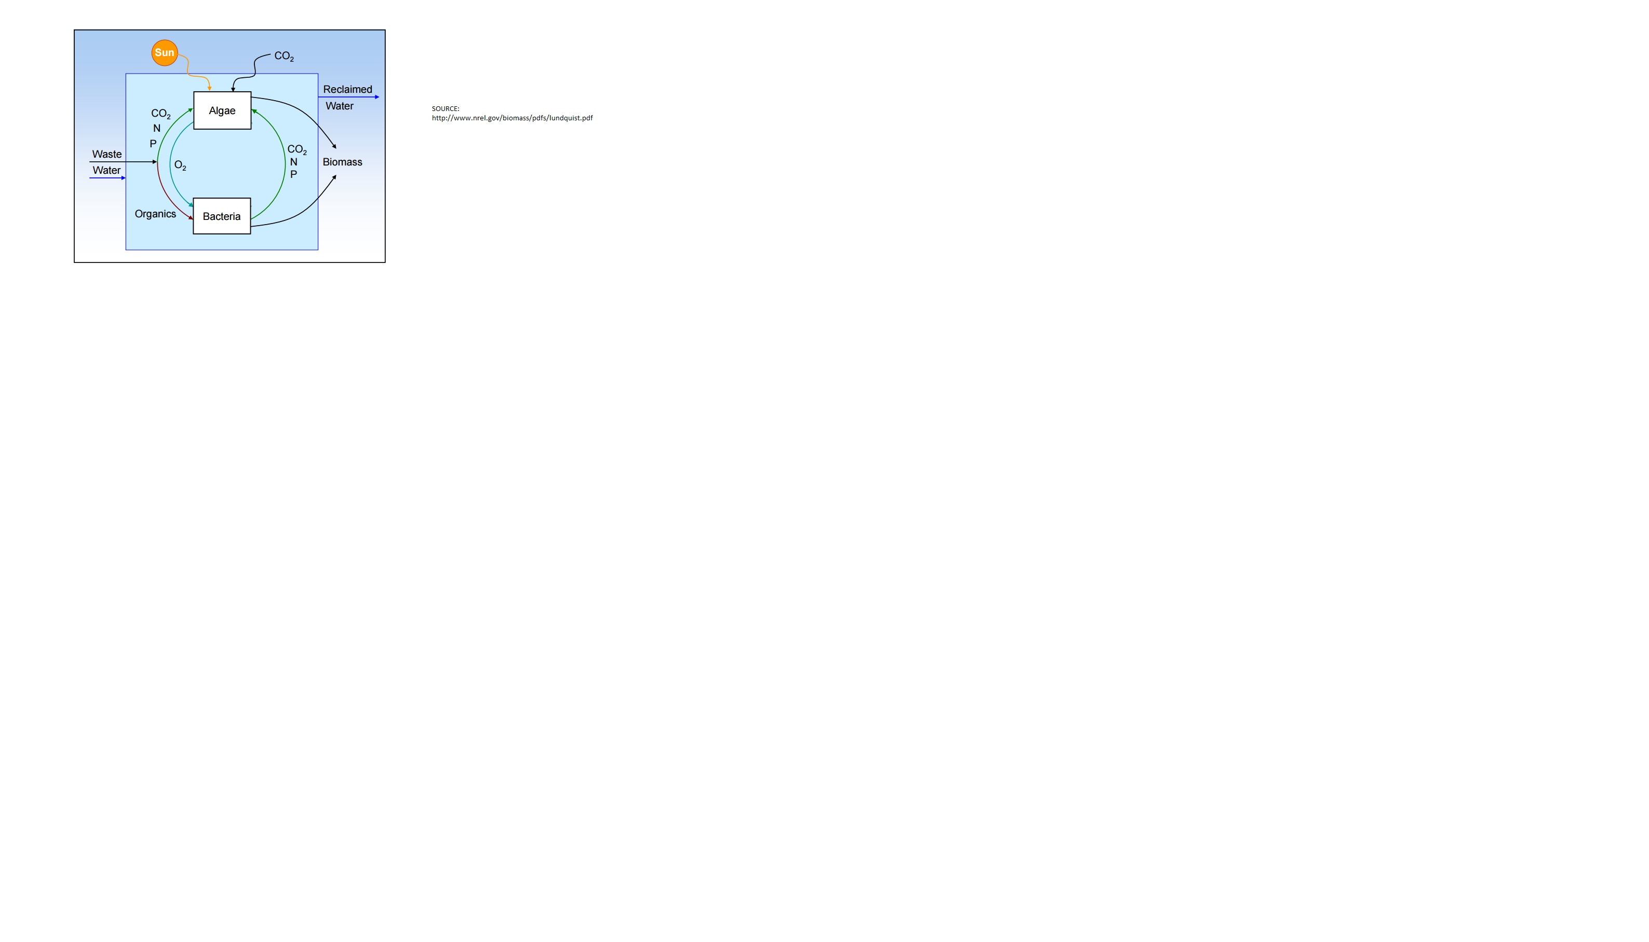
Manuscript #2
Foster and exploit algal – bacterial synergy, centered around CO₂ flux.
“In a world with an exponentially increasing demand of microalgal biomass for novel applications, one of the key challenges would definitely be the controlled integration of specific bacteria in the massive production processes of a specific microalga” (Fuentes et al., 2016)
How might we accomplish this?
Source: National Renewable Energy Laboratory
Notes:
Seems logical, but the question is, what is the best way to actually do this? Are there growth systems for this? Some, but problem is…(something about how growing
them together in the same biofilm is not ideal, complicates things, difficult to troubleshoot, likely not feasible for scale up)…
-“In a world with an exponentially increasing demand of microalgal biomass for novel applications, one of the key challenges would definitely be the controlled integration of specific bacteria in the massive production processes of a specific microalga” (Fuentes et al., 2016)
Augment conventional treatment strategies (bacterial based) with Algae, to achieve enhanced removal of inorganic nutrients while generating usable algal biomass.

Slide 7
DUAL BIOFILM ALGAL GROWTH SYSTEM – PROOF OF CONCEPT
Light
Photoautotrophic (algal) biofilm
Heterotrophic (bacterial) biofilm
CO₂-permeable opaque silicon
tubing
¹⁴C “Wastewater”
¹⁴CO₂
CO₂ produced via bacterial biofilm metabolism diffuses across silicon tube to outer algal biofilm.
Light
Inside of the tube will be fed ¹⁴C-labelled glucose. The outer biofilm will be harvested and subjected to liquid scintillation counting to quantify the amount of ¹⁴C subsequently incorporated into the algal biomass. The bulk liquid in which the tube is submerged will be counted by LSC to quantify ¹⁴C.
Notes:
Have the tubing interwoven through some sort of framework (like a BBQ grill), and you can even rotate it using a BBQ spit to ensure the entirety of the tubing receives equal light. OR USE THIS PRINCIPLE IN A ROTATING ALGAL BIOFILM REACTOR DESIGN

Slide 8
Questions & Considerations
Ultimately, it would be ideal if our design is able to circulate and treat the same WW stream inside and outside the tube, but for PofC, we will first need to keep both as closed systems.
Which strain(s) will we use?
Initially pure culture bacterium inside tube, and pure culture algae outside?
Considering this will be proof of concept, what will be our perturbations? Perhaps starvation, depending on the insight provided by manuscript #1?
To what extent should we analyze the outer (algal) biofilm?
Lipid analyses?
What is involved in preparing algal biomass for LSC?
Any patenting potential?

Slide 9
Manuscript #3
Characterizing and optimizing the system. Moving beyond proof-of-concept.

Slide 10
Manuscript #3
This manuscript will explore the optimization of the dual biofilm growth system, focusing on assessing and enhancing its industrial applicability
Use real, unsterilized wastewater as inoculum, and quantify inorganic nitrogen removal
Characterize the biofilms that subsequently form on the inside and outside of the tube (ie. member composition (qPCR), thickness, and chlorophyll content (CLSM))
Optimize the system in order to enhance algal lipid production (ie. is the algal biomass that accumulates on the outer tube useful for downstream applications?)
Explore the feasibility of circulating the same wastewater inside and outside the tube, such that the inner heterotrophic biofilm removes organics, while the outer algal biofilm removes inorganics
Can we make the system energy neutral?

